Slide 1
Test Plan
CampManager
MEINF UDL – EPS 2022-2023
Notes:
Alejandro

Slide 2
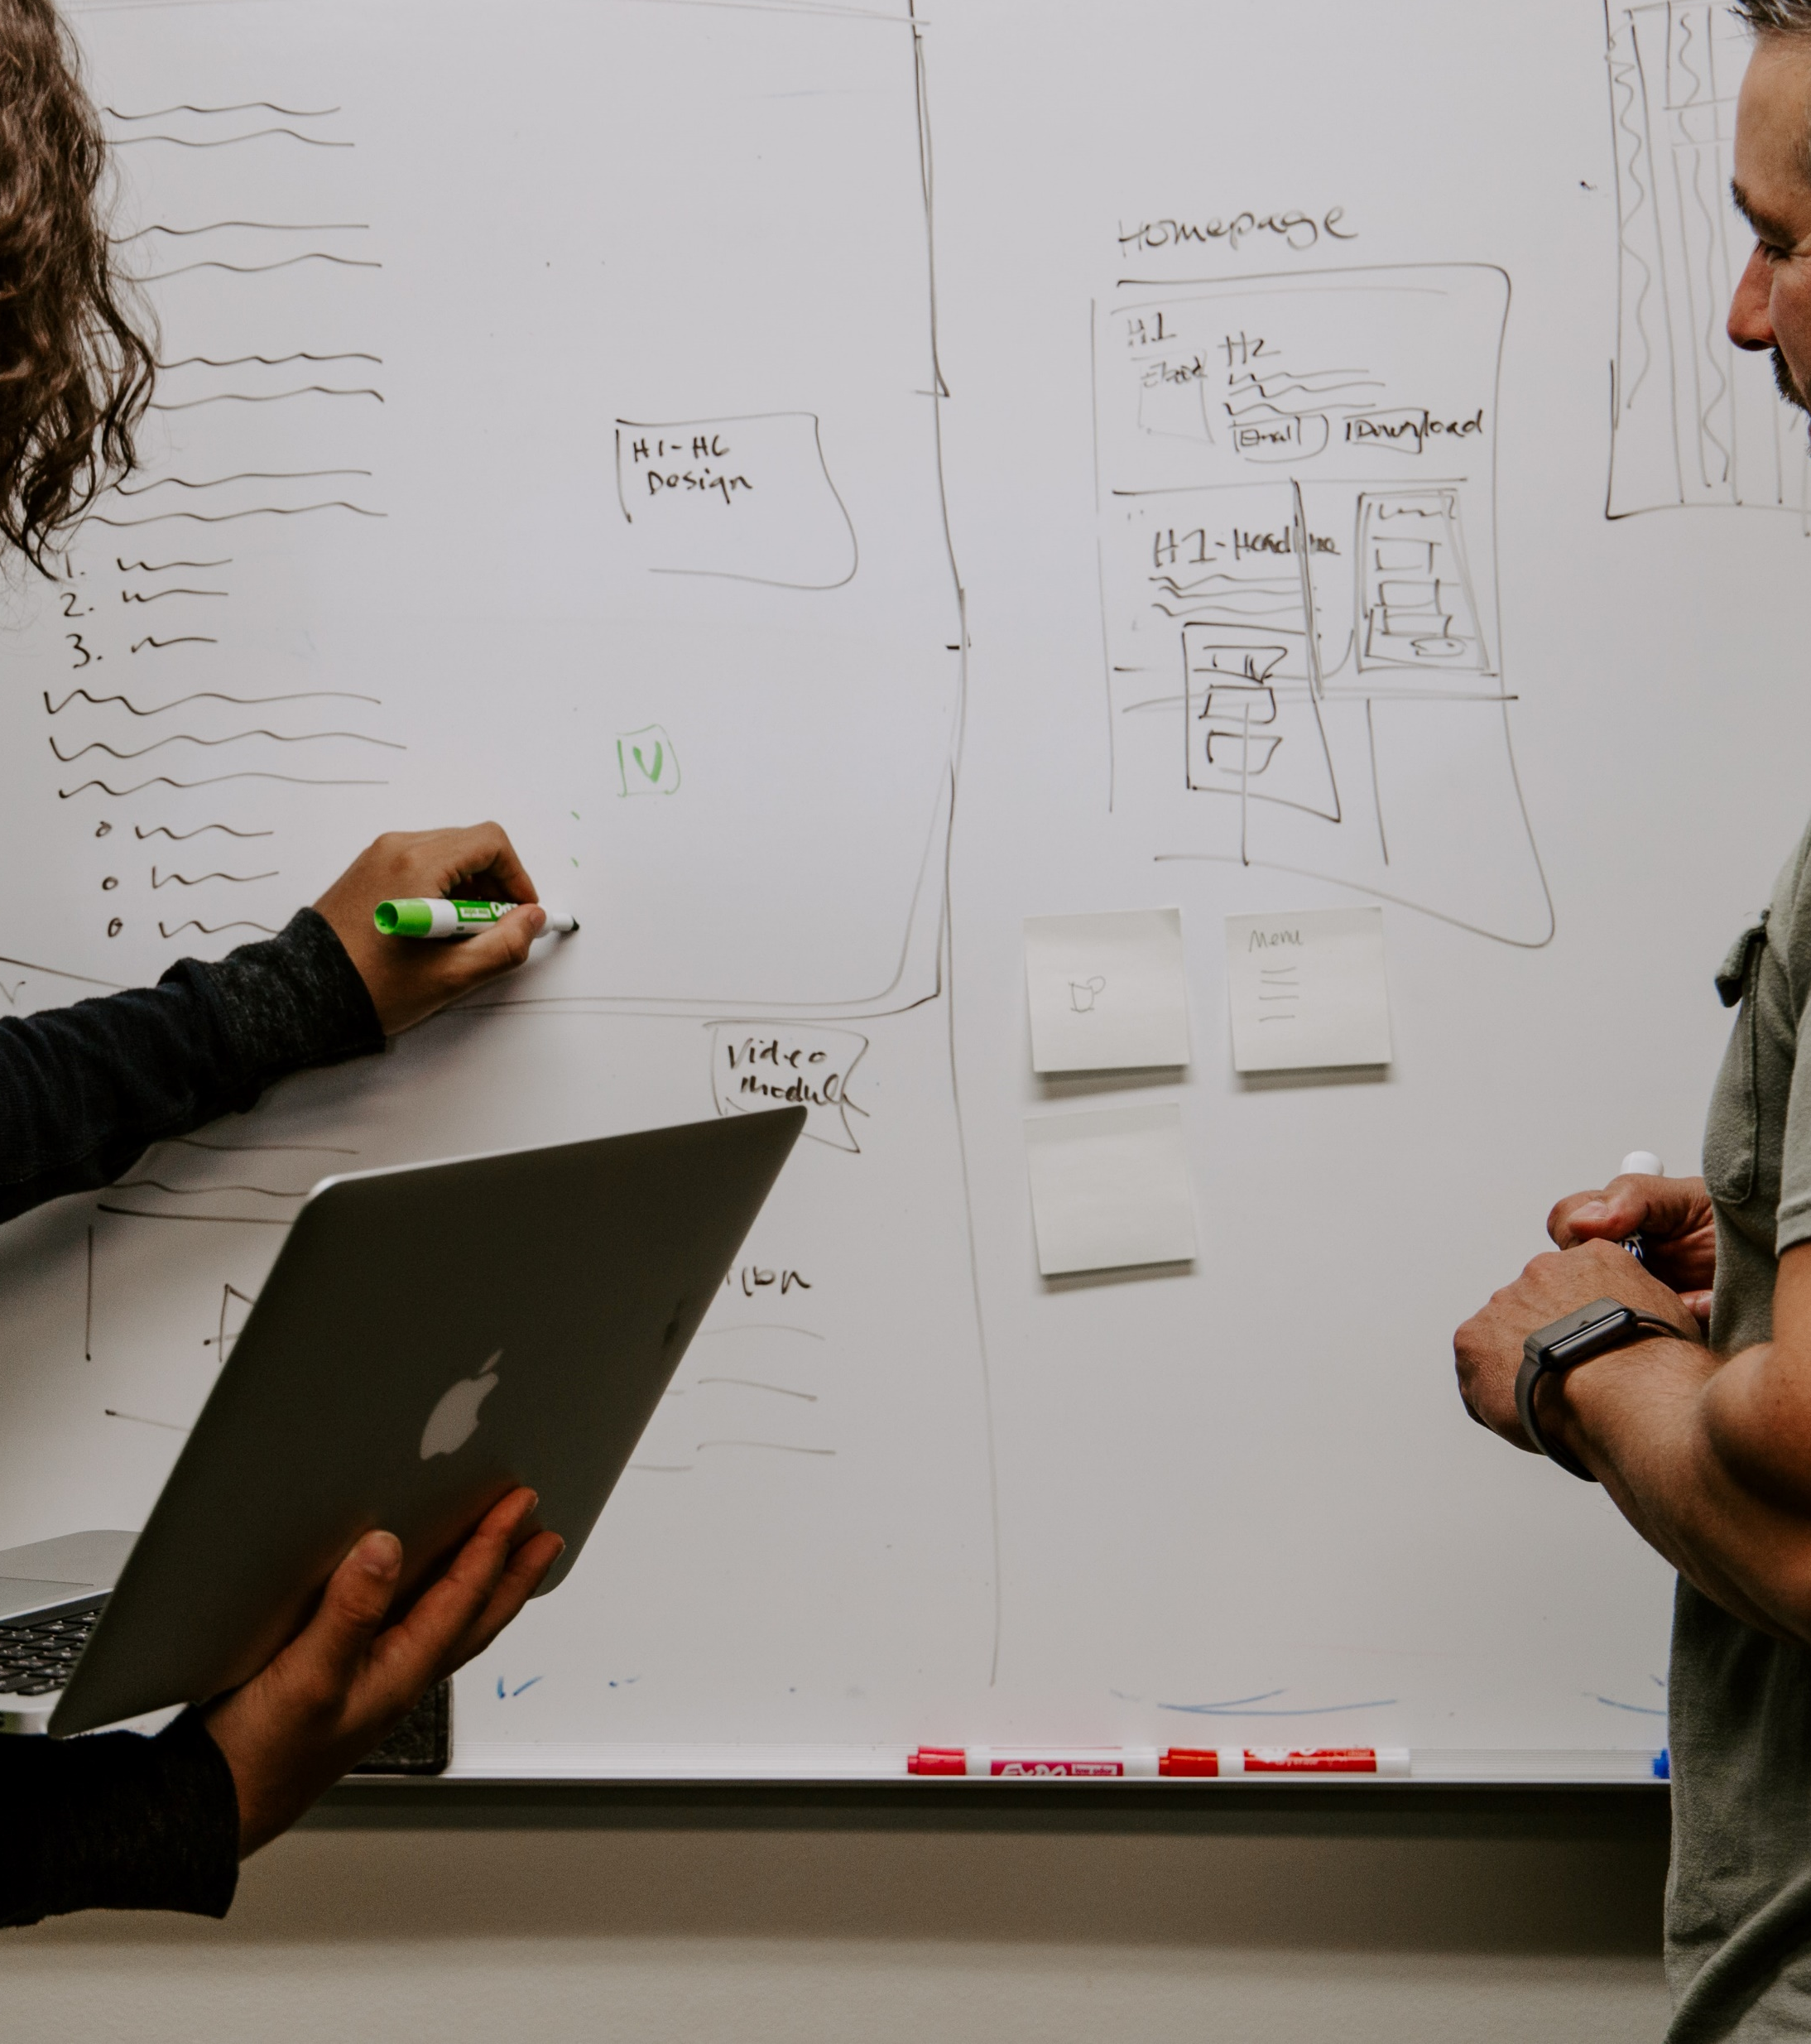
Introduction
Product definition
Purpose and test objectives
Target audience, user profile definition and target user sample
Participant recruitment process
Methodology
Test environment and equipments
Metrics
Notes:
Alejandro

Slide 3

Product definition
The team made the decision to generate a management tool for organisations focused on managing the members of the organisations that manage summer camps, with extra tools.
Currently the application has implemented the necessary functionalities to create, manage and modify organizations, camps, and counsellors.
Notes:
Alejandro/Jordi

Slide 4
Purpose and test objectives
Being able to access the tables page and realize the action is not a trivial task.
The user might not know how to add an organisation while being in another organisation’s space.
The system does not instantly generate the tables, so the user might think there is an error and get nervous if the system’s message is not effective.

Slide 5

Target audience
Camp Managers
Camp participants
Monitors and Counsellors
Parents

Slide 6
User profile
User profile 1
Age: 16-29
High technology experience
User profile 2
Age: 30-50
User profile 3
Age: +51
Frequent use of mobile devices
Low/medium experience in the field of summer camps.
Medium technology experience.
Moderate use of mobile devices.
With experience in the field of summer camps.
Low technology experience.
Reduced use of mobile devices.
With experience in the field of summer camps.

Slide 7

User sample
Gender:
Men (50%).
Women (50%).
Age:
Between 16 and 29 years old (50%).
Between 30 and 51 years old (40%).
51+ years old (10%).
Technological knowledge:
High technological level: (40%).
Medium technological level: (50%).
Low technological level: (10%).

Slide 8
Participant recruitment process
Identify the characteristics and skills that are needed in the participants
The recruitment process begins using the Screen form
Identification of the recruitment needs.
The team prepare the necessary material
Candidates selected
Usability test

Slide 9
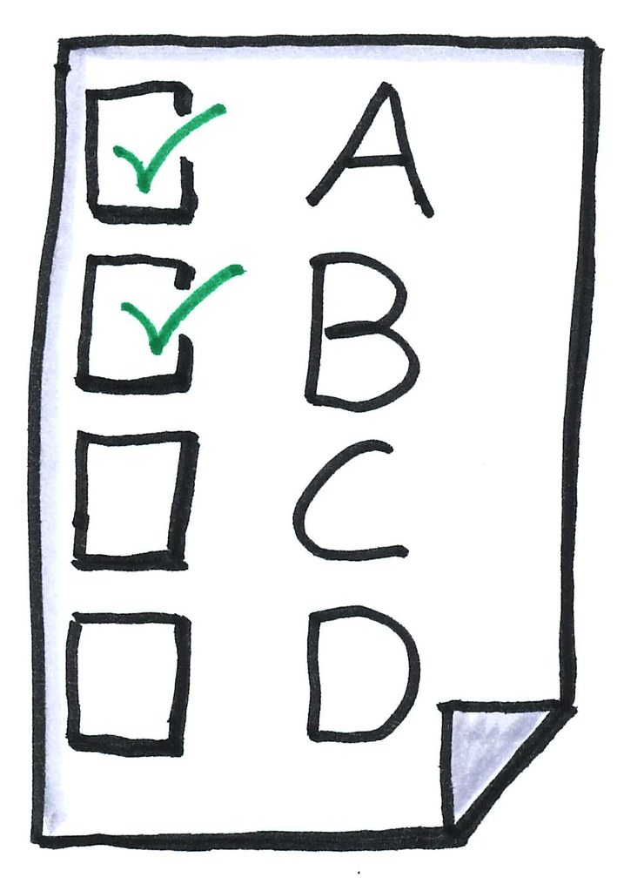
Procedure and protocol
Welcoming and pre-test (8min)
Task scenarios (21min)
Task 1
Task 2
Task 3
Post-test questionnaire (7min)

Slide 10
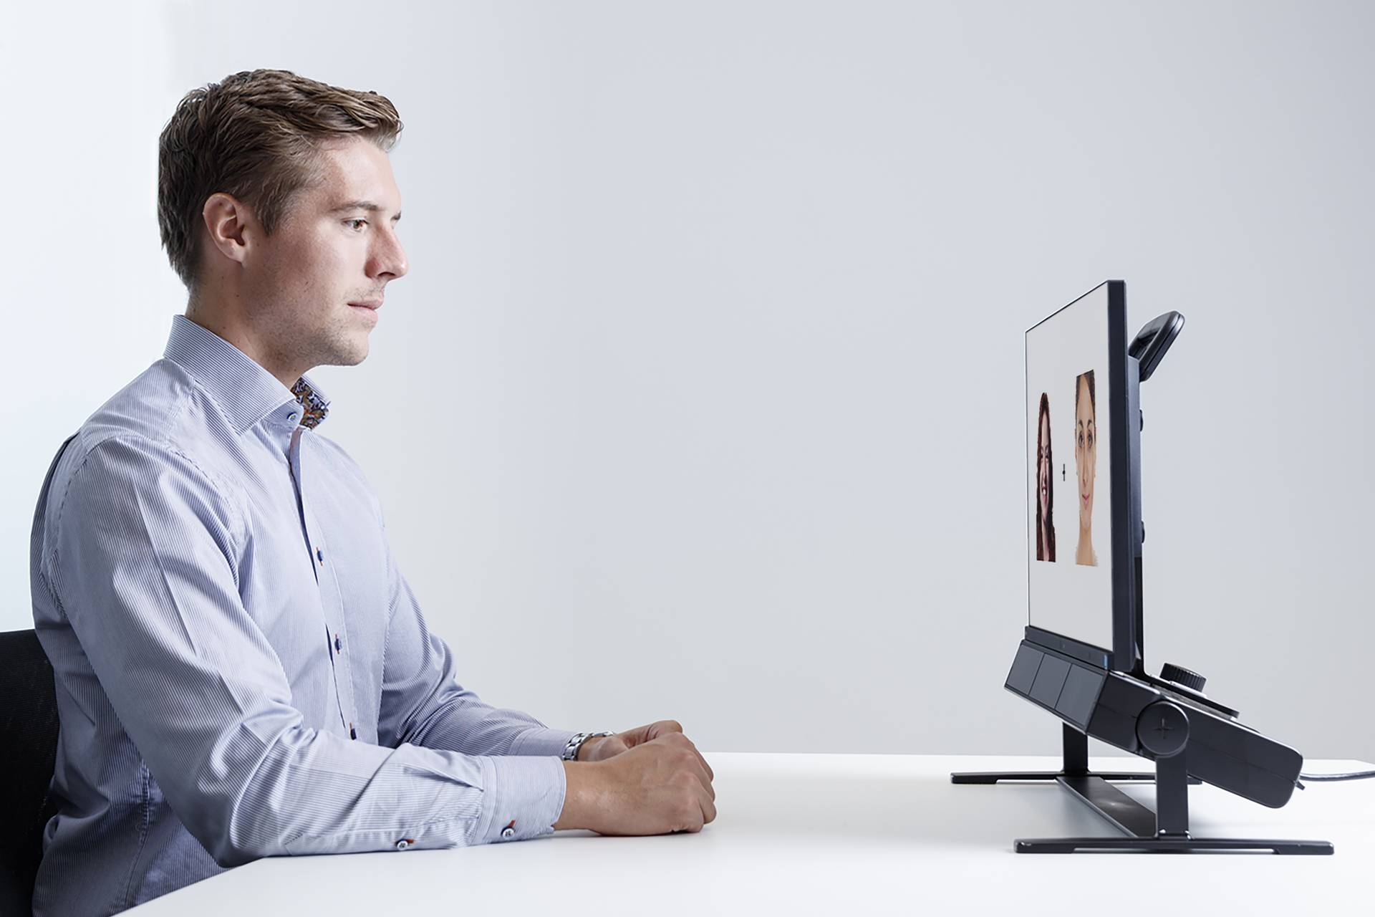
Eye tracking
Eye-tracking technology will provide additional data to fulfil the test's objectives.
To track participants' gaze during the test, we will use Tobii Studio Pro software in the laboratory.
This data will help us evaluate if our interface structure, objects, and design architecture are well-organized, enabling the user to efficiently complete task objectives

Slide 11
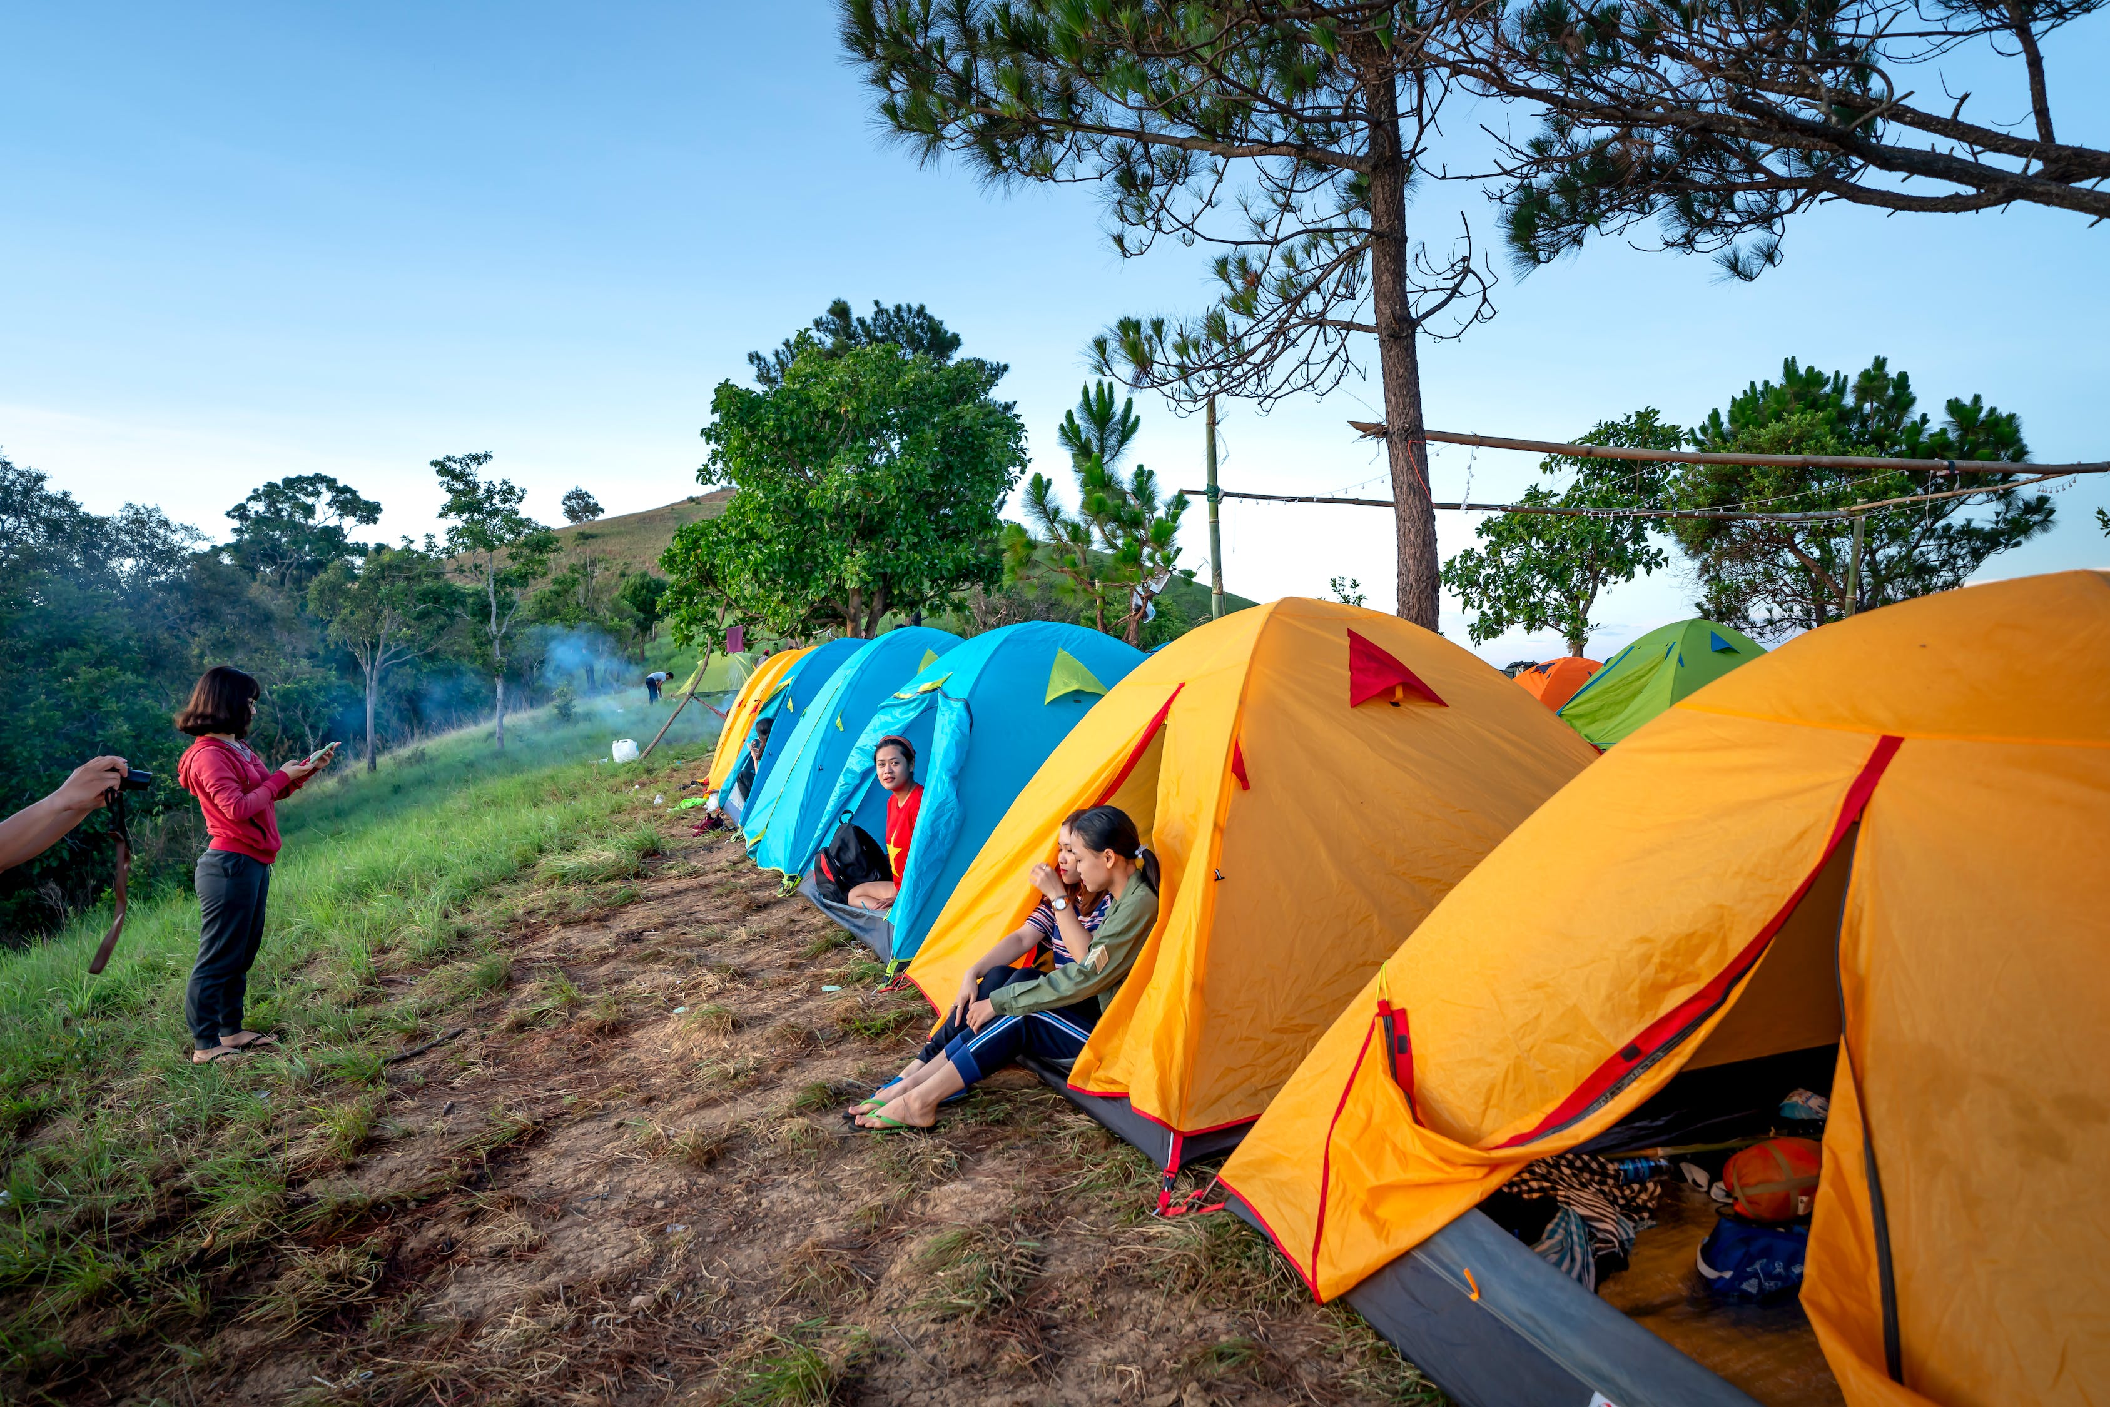
Number of participants
Gender:
Men: 11 participants.
Women: 11 participants
Age:
Between 16 and 29 years old: 11 participants.
Between 30 and 50 years old: 9 participants.
51+ years old: 2 participants.
Technological knowledge:
High technological level: 9 participants.
Medium technological level: 11 participants.
Low technological level: 2 participants.

Slide 12
Description of the tasks to be evaluated
Tasks 1: Create campaign table from main organisation page
Task 2: Validate if the table is created and its status
The objective of this tasks validates if the user can see the message, or it is necessary to remodel the format of the message.
Task 3: Add a new organisation in his space while being in some organisation’s space.
The objective of this task is check if the user can find the tables creation panel and create a new table.
The main propose of this task is check if the user can see the button and check the user’s failures during the tasks.

Slide 13
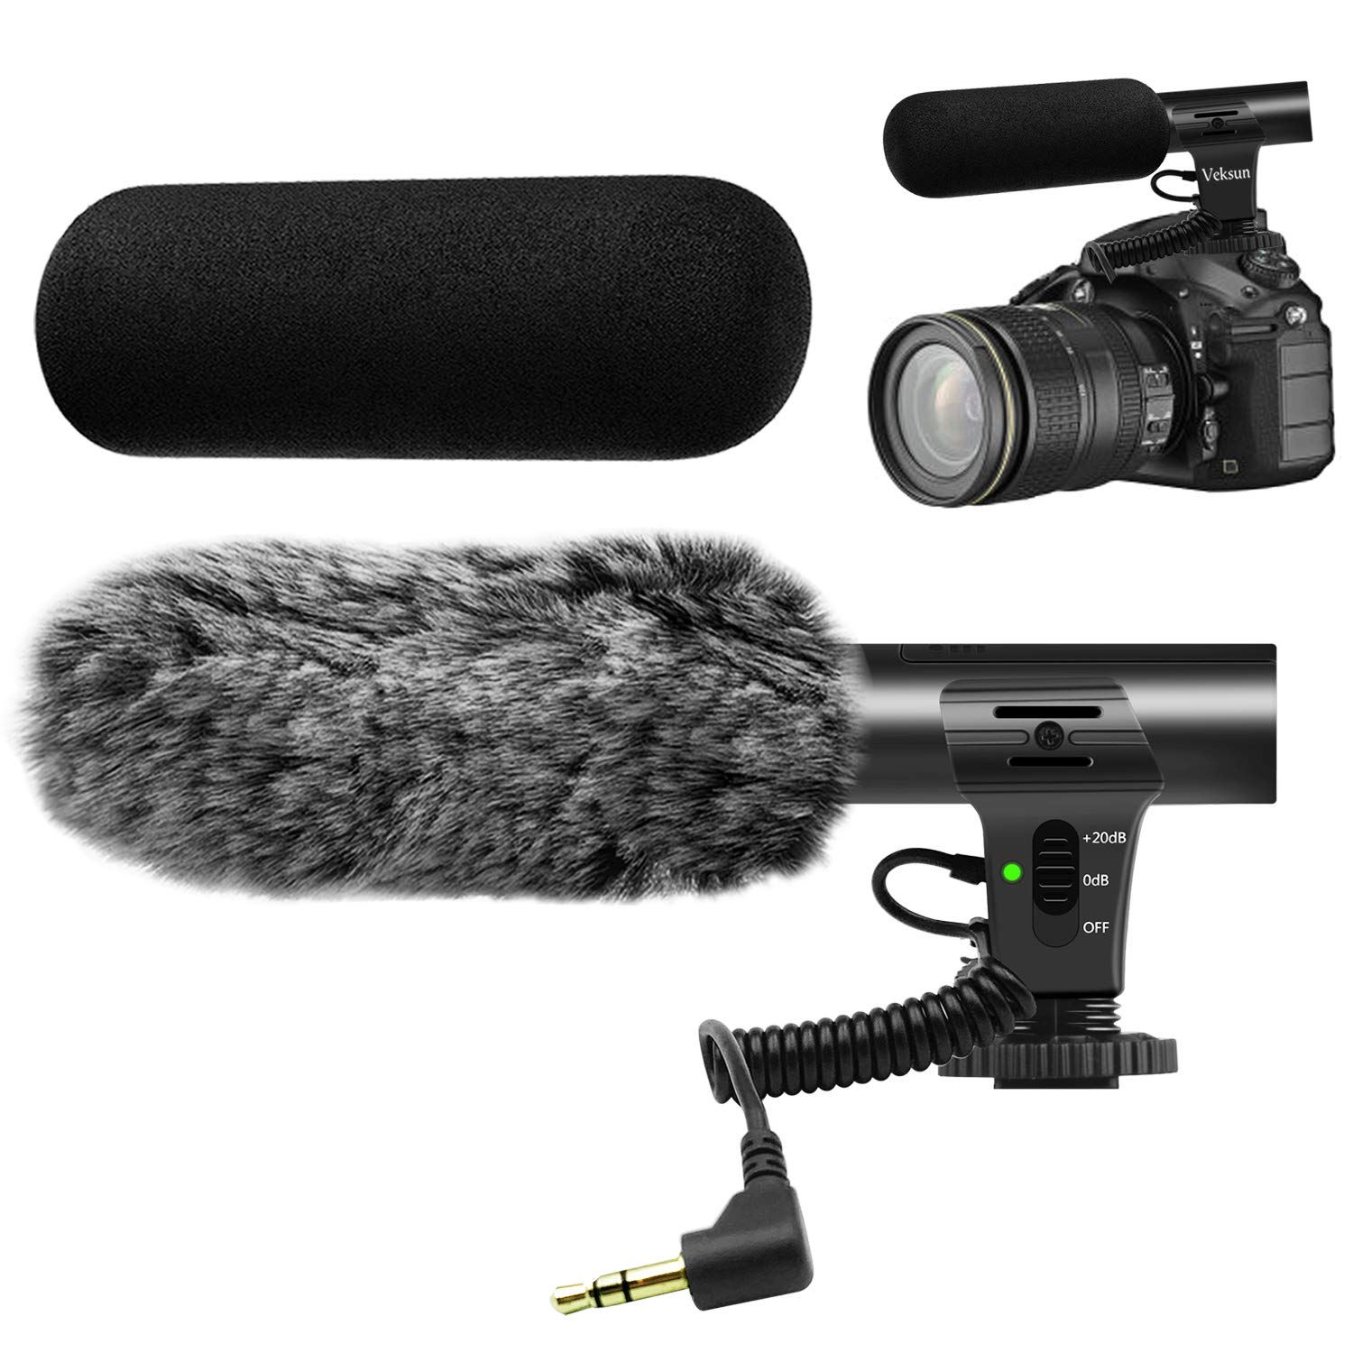

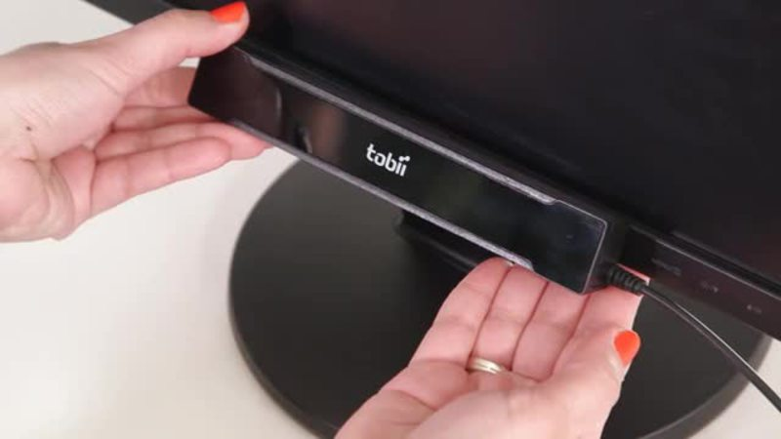
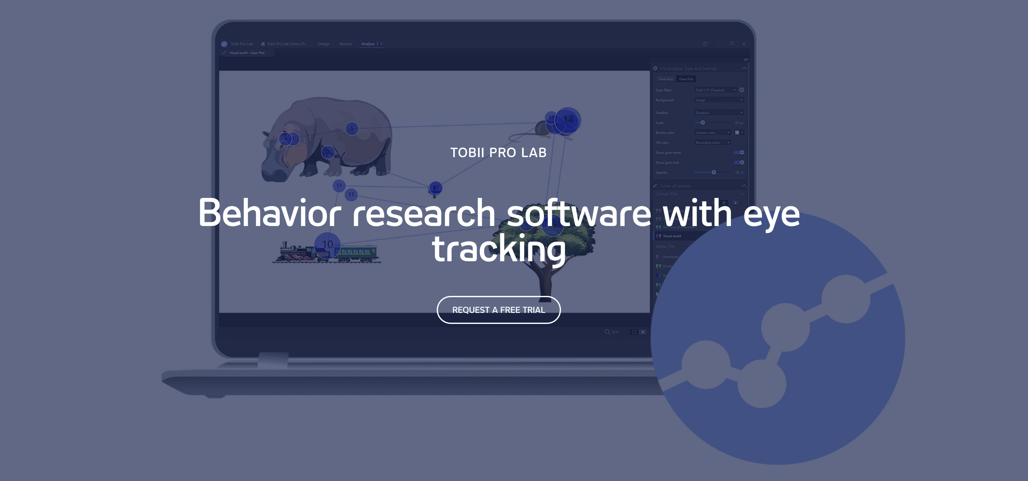
Test environment and equipment
User space
A computer.
Tobii eye-tracker.
Camera/Microphone.
Observers space
A computer.
Video recording studio (Tobii Studio software).

Slide 14
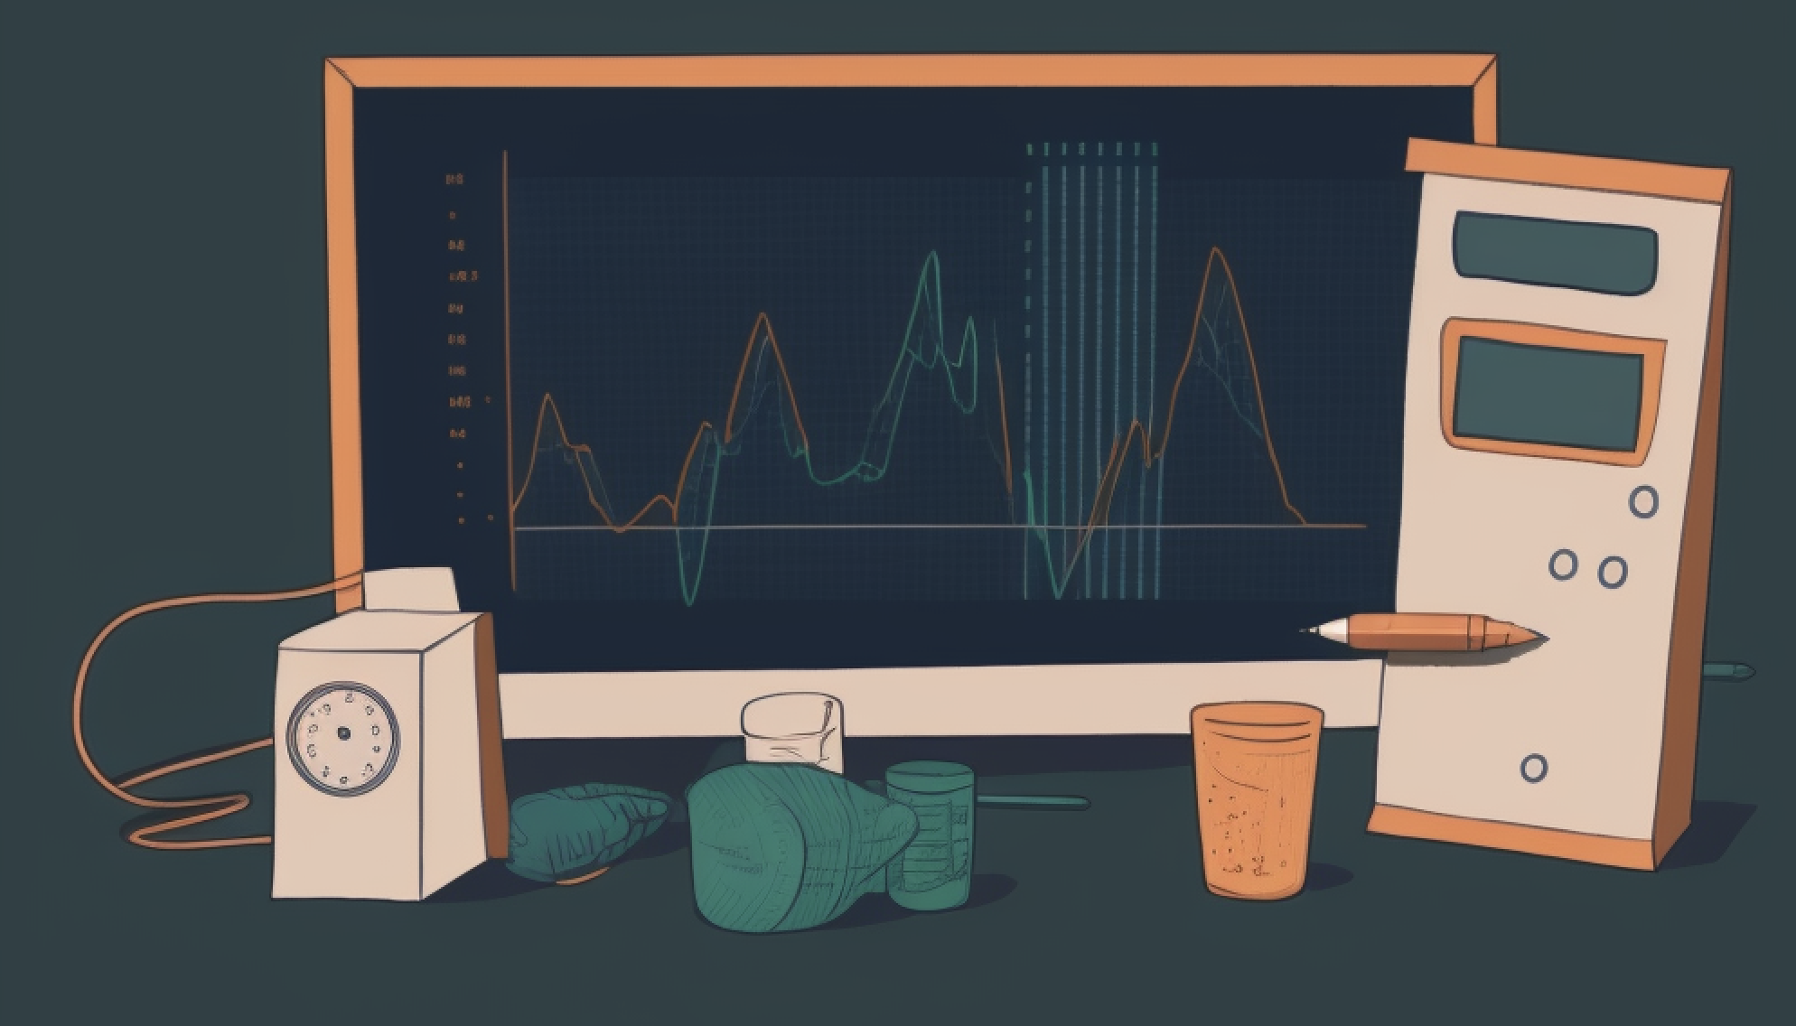
Metrics
Effectiveness
Efficiency
User satisfaction
Eye-tracking metrics

Slide 15
Effectiveness
Task success rate

Slide 16
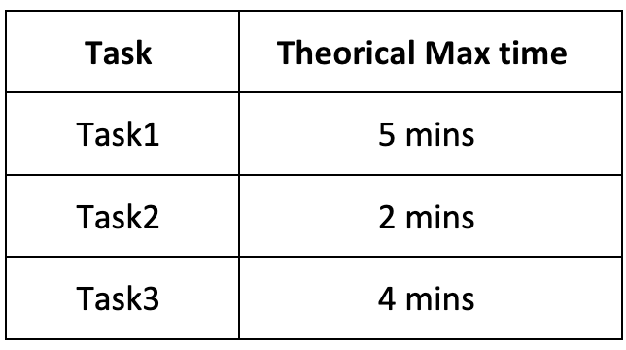
Efficiency
Time required to complete a task.
Number of errors made during the task.

Slide 17
User satisfaction
Percentage of users who think that their experience has been satisfactory at the end of all tasks.
Number of positive/negative expressions/comments during the development of a task.

Slide 18
Eye-tracking metrics
Average duration of the user fixing a single point on the screen.
Percentage of users looking at an area of interest.

Slide 19

Thank You For Your Attention!

